Slide 1

Hierarchical Clustering Integrated with Transformer model for XMC
Bachelor Thesis Project - 2
Bade Naga Manikanta Praveen
Under supervision of Prof.Mahesh Mohan M R

Slide 2
Contents:
1)What is XMC
2)Challenges involved
3)Problem statement
4)XMC with only T5 Transformer
5)Techniques to partition data in trees
6)Hierarchical K means clustering
7)XMC with Hierarchical K means clustering + T5
8)Results
9)Discussion

Slide 3
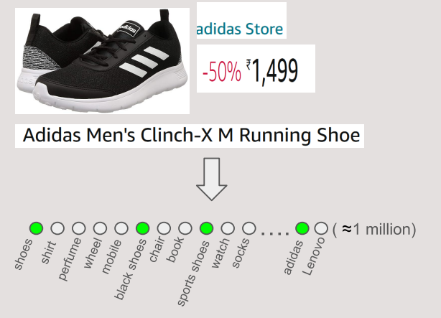
What is XMC
The Aim of Extreme Multilabel Classification(XMC) is to assign most relevant subset of Labels to the datapoint from extremely large label set
There are several real world applications to this problem that includes:
a)Amazon : Tag product with
relevant labels.
Ex: Product => Wireless Earbuds
labels in Amazon website can be
Electronics >Headphones >
Bluetooth Earphones
Note: We are working on a problem which is very close to above problem
Indoml poster

Slide 4
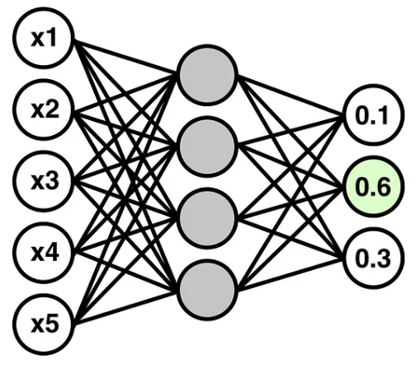
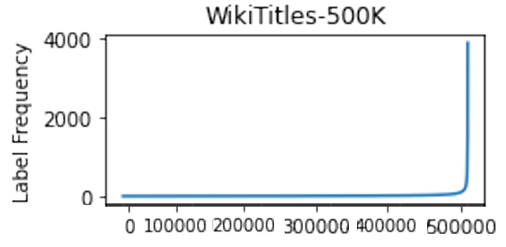
Challenges Involved
When we have millions of labels its really hard to train model efficiently ,too many labels make it very difficult train and train the model.
Ex: let us say we are trying to solve the problem by
vanilla neural network , Now assume Output
having million nodes from which need to
choose subset of labels by training deep
vanilla neural network is hard
Another Challenge is to retrieve Tail products (Ex: Baby Helmet in Amazon) which are very rare , The scarcity of data makes it difficult for models to learn and accurately classify rare items.
https://medium.com/data-science/coding-up-a-neural-network-classifier-from-scratch-977d235d8a24
(Dasgupta et al. 2023)

Slide 5
Problem statement
1) Given:
a) Description: Detailed item description: Wireless Earphones Bluetooth 5.0 Headphones, 40H Playtime w/Wireless
Charging Case, IP6 Waterproof/Button Control/TWS Stereo Bluetooth
Earphones in-Ear w/Mic Headset
b)Retailor : Retailor source of item : Shenzhen Shouhui Chaopai Technology Co.,
c)Price: Price value associated with product : 20
2) predict:
SuperGroup: Electronics
Group: Headphones
module: Bluetooth Earphones

Slide 6
Some observations :
1) The last most category (module) is most specific category
2) Each label in specific category has one to one correspondence to SuperGroup and Group categories eliminating the need to predict the SuperGroup and Group categories separately
3)So from training data, we will store maps with respect to most specific category
Ex: Bluetooth Earphones => {Group: Headphones,SuperGroup: Electronics}
4) So whenever our test point outputs Bluetooth Earphones(we will make our model to output module),from map we can get Group and Super Group
5) So now our potential space of labels are only most specific labels
6) So from now label are module are interchangeably used from now on,both meaning module

Slide 7
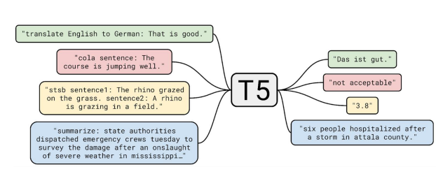
XMC with only T5 Transformer
Developed by Google AI
T5 reimagines NLP as simple text to text problem
So it allows T5 to handle so many NLP tasks
The three fields are combined into single input string
(Raffel et al. 2020)
The model is asked to output the module
Above is the supervised Fine tuning task we are performing
The drawback of this model is that it is not solving Tail label Challenge

Slide 8
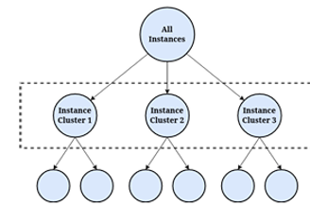
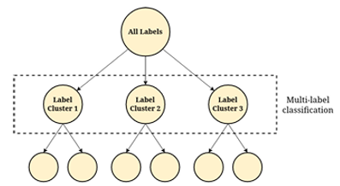
Techniques to partition data in trees
Sample Based Partitioning
It groups together the train samples and
cluster them into branches at each level
2) Label based partitioning
It relies on dividing the labels into clusters at
each level
we have choosen Label based partitioning
because it is scalable and it seperates tail
labels from head labels and helps in
Transformer distinguish between them
(Why => we will see in next slide)
(Dasgupta et al. 2023)

Slide 9
Hierarchical K means clustering
Step 1: Bert based extraction for each module
Step 2: Consider all modules in the root node
Step 3: Traditional Tree based clustering algorithms generally have only
2 children and are balanced , but we believe this will force tail labels
to group with head labels and reduce their representation by allowing
more children (eg: 6) we provide greater flexibility to tail labels to
clusters of their own and ensure they are fairly represented
Step 4: Recursive K means clustering (base case: leaf node <6 labels)
Step 5: Label encoding through prefix codes which enhances Transformer to
distinguish between head and tail labels and focus on outputting
tail labels when their turn comes as they are better represented in
their cluster and differentiated from head labels
So each module is encoded with unique array of numbers

Slide 10
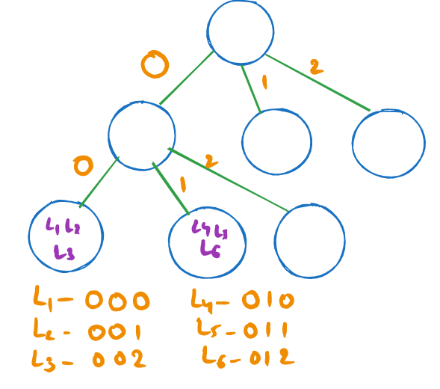
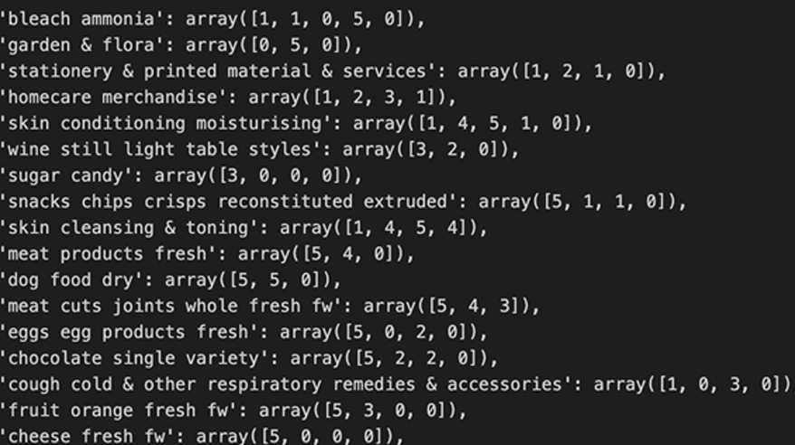
Visualisation of label encoding
Clustered Output

Slide 11
XMC with Hierarchical K means clustering + T5
The three fields are combined into single input string
The output is the label encoding generated through hierarchical clustering.
Specifically, instead of outputting the raw module name, the model is trained to predict the corresponding sequence of integers (prefix code) that
represents the module’s position in the cluster hierarchy

Slide 12
Results
The accuracy has increased from 79.18% (Plain T5) to 83.8% (Hierarchical Clustering + T5) because of mechanism setup to enforce classification of Tail labels
We can conclude that Integrating hierarchical clustering with the T5 model proves to be reliable strategy for addressing the tail label Challenge in XMC
We have discussed theoretically ( because clustering helps the transformer to distinguish between head and tail labels due to prefix encoding,and transformer can focus on outputting tail labels when their turn comes as they are better represented in their cluster and differentiated from head labels) and this trend is also observed experimentally in results section

Slide 13
THANK YOU

